Slide 1
Table of Contents
Architecture Overview
Data Platform – Conceptual
Data Platform – Technology Components
Pre-requisites
Network Diagram
Network Diagram – Overview
Network Ingestion Flow
Ingestion Connection Table
PBI Network Flow
PBI Connection Table
Admin/User Network Flow
Admin/User Connection Table
References
Medallion Architecture
Synapse Dedicated Pool vs Serverless Pool

Slide 2
Version of Controls
Version | Date | Author | Rationale
1.0 | 25-May-23 | Quang Trinh | First Draft Version
2.0 | 29-May-23 | Quang Trinh | Add Network Ingestion Flow, PBI Network Flow and User Network Flow
3.0 | 31-May-23 | Quang Trinh | Add Medallion Architecture & Pool Comparison
4.0 | 2-Jun-23 | Quang Trinh | Add Pre-requisites

Slide 3
Data Platform - Conceptual
Data Sources
Ingest
Transform and Enrich
Serving
Consumption
Create
Ingest
Process, transform, and computations of ingested data
Data Serving
Capabilities to query raw and transformed data in Data Lake and other applications, like Power BI.
Making data available for querying for different consumption types
Reporting
Self-serve reporting (e.g. Power BI)
Data sources
Connection with all kind of data sources.
The type of data can be batch (database, API, files) or live data (event streams, sensor data, live updates from databases)
Data ingestion
Enable flow of data from source to Data Lake in batch or real-time. Keeping the data integrity
Advanced analytics(Not in scope)
Synapse Analytics Workspace
Downstream application
Data Platform storage
Storing raw, structured, semi-structured and unstructured data in optimized structures to enable fast data processing
Support and Operate
Orchestration, Monitoring and alerts, usage tracking, CICD, Data ops / incident management process
Govern and Protect
Data Protection, Data Catalog, Life cycle data
Notes:
Data Sources:
These are internal and external data sources containing high data volumes.
Ingest:
The external data is ingested (brought) into the Data Lake. This happens via different mechanisms, like: “files”; “database connections”, “API” (Application Processing Interface) and “event or message streams”. Ingestion will often include storing the data in the Data Lake storage in a format which may or may not be same as source format. E.g: you may read a “csv” file and write it as “JSON” or “Delta” file in the Data Lake storage.
Transform and Enrich:
As part of this block, it is possible to transform the ingested data into more workable data. E.g. computing measures by aggregating raw data, or transforming raw data fields to attributes.
(Azure) Data Lake storage:
This stores the ingested data either in the original format or in the transformed and enriched format. Data tables can be created and stored in Azure Data Lake Storage (ADLS) in “Delta Table” format. Tables stored in ADLS and in “Delta Table” format can contain big data. This way of storage is preferable, because it is most cost effective, and easy to access for “Consumption”.
Serving:
Data from the Data Lake storage can also be made available for “Consumption” via different “Engines”. These engines (Synapse Spark pool; Synapse Dedicated pool; Synapse Serverless) are used when the Consumption is requested via files, API or SQL queries.
Consumption:
Consumers can have different data consumption requests:
Consumption of data from all kinds of Analytic applications, like Power BI, SAP Embedded Analytics. These tools will mostly use SQL language to query data from Data Lake
Consumption of data routed via other more advanced analytics and programming tools like Python or R for advance data processing and Machine Learning, for Artificial Intelligence purposes.
Consumption of data for specific applications which need data from data lake to support specific business processes

Slide 4
Data Platform - Technology Components
Create
Ingest
Transform and Enrich
Serving
Consumption
Data Sources
Ingest
Engines that will be used:
1. Synapse Dedicated pool (SQL Scripts and Stored Procedure)
2. Synapse Serverless Pool (SQL Scripts) (TBD)
Data Serving
Capabilities to query raw and transformed data in Data Lake and other applications, like Power BI.
Engines that will be used:
1. Synapse Dedicated pool (SQL Scripts)
2. Synapse Serverless Pool (SQL Scripts)
Reporting
1. Power BI
2. Embedded Analytics in apps
Data sources (E.g.)
SAP ECC
DMS (Oracle DB)
SAP Tcode (TBD)
Manual Excel Files
1. Synapse Pipeline (Copy Activity - Polybase)
2. Power App feeds data entry through form input and file upload
Advanced analytics
1. Azure Synapse Analytics
Downstream Applications
(Not In Scope)
Data platform storage
ADLS (as raw file format from source or Delta tables) - Lakehouse
Synapse Dedicated pool (regular tables) - Warehouse
Support and Operate
Synapse Pipeline, Azure DevOps, Azure Monitor, Key vault
Govern and Protect
Microsoft Defender for Cloud, Cloud Workload Protection (CWP)
Notes:
Data Lake Storage
In ASM, the Data Lake storage will comprise of following:
ADLS: This is the primary and preferred storage. It will store two types of data:
As-is raw data from source; in the same format as source (CSV, JSON and others)
When it comes to storing data as table (rows and columns) it is recommended to store data in Delta tables. “Delta” format is preferred because of following reasons:
It guarantees the data types for the columns (E.g., it will ensure a column with the data type “Date” only contains values which are date; or integer column contains data values are which are strictly integer)
It enables data compression when storing data, which will result in less storage cost
It supports concurrent read and write by multiple users
On exception basis, you will use Synapse Dedicated SQL pool tables for following situation:
To provide granular security (column and row level security)
Need of serving layer with fixed cost
Business Analytics team has familiarity/preference to extract data with SQL to explore data and process tables
Size of total data does not exceed in 100GB for a given table (for large tables, its recommended to leave them as Delta tables on ADLS
Serving
Data is made available to the consumer as per following:
For consumption by Power User via the BI tool or SQL queries they will leverage following:
Serverless SQL pool: for querying Delta tables stored in ADLS
Dedicate SQL pool: for querying data which is stored in Dedicate SQL pool
For Machine Learning consumption or exploring data using programming languages like Python and R, the Synapse Spark Pool via Spark Notebooks will be used. The Spark pool supports reading and writing data from both Delta tables in ADLS and as well as from Dedicated SQL pool.
Furthermore, there can be data consumption requests for IT applications. This can be done via Serverless SQL pool, Dedicated SQL pool, Spark Pool, or via direct access of the data in ADLS storage.

Slide 5
Pre-requisites
SAP System
SAP credentials
Authorization for using Remote Function Call (RFC) destinations.
Permissions to the Execute activity of the S_SDSAUTH authorization object.
Reference: https://learn.microsoft.com/en-us/azure/data-factory/connector-sap-table?tabs=data-factory
SAP Connector for Microsoft .NET (to be installed in SHIR)
Reference: https://support.sap.com/en/product/connectors/msnet.html
Note: please download this version: SAP Connector for Microsoft .NET 3.0
DMS System
Oracle DB credentials (Read permission)
Oracle Client (to be installed in SHIR)
Others
PVCFC VPN
Notes:
Split copy activity into 02 stages (ingest into landing firstly (folder Inbox) and move into process folder) -> inbox empty
+ Full load
Landing (SRI): parquet
Source / Inbox : Ingest entire table into folder Source (flat)
Processed: Moved after loading successfully into Bronze
Date (Year/Month) / Table Name (BSEG) / *.parquet
Failed: Moved after loading failed into Bronze
+ Incremental Load
Landing (SRI): parquet
Source / Input: Ingest table (for example BSEG > 01/Jun/23) into folder Source
(Loop pipeline for one each table)
Bronze (split into etl, sap, dms, manual)
(real: 400 dif systems, sap_906, sap_907)
- T001
- BSEG
MARA
VBRK
VBRP
Silver (Physical Table) (source items -> key, besides order no, order item)
Renaming
Filtering (delete flag)
Derived
Cleansing
Join / Look up
For example: Inventory Details -> Inventory Balance / Aging (snapshot)
For example:
Fact_Billing_Order_Item (VPRK_VBRP)
Dim Material (MARA)
Gold (View) -> Consumption
Aggregate Data
Filtering
Derived
Another name prefix (Pull data for app) (3rd dept purpose)
For example:
Fact_Billing_Order_Item
Dim Material
Fact Monthly Billing (Aggregate from fact billing order item)

Slide 6
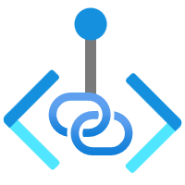
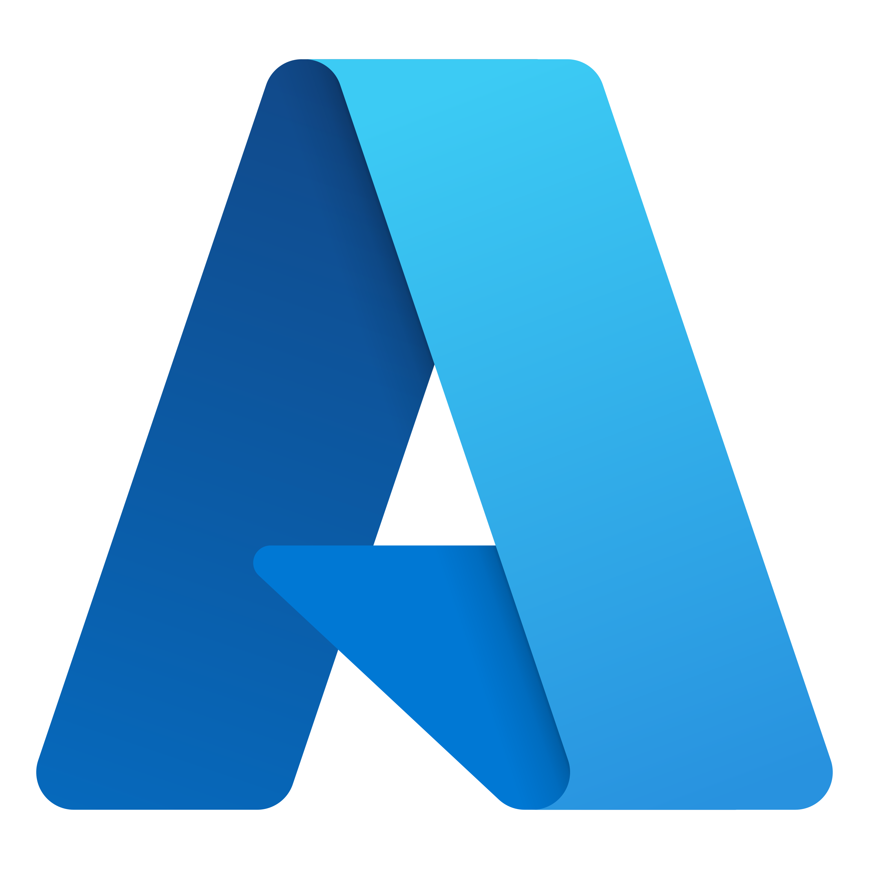
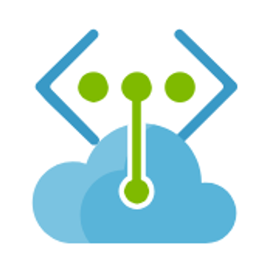



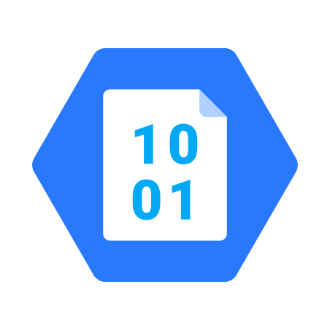
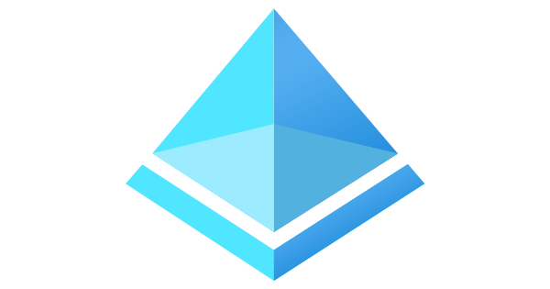

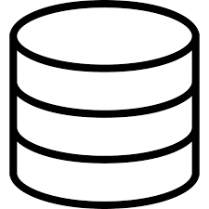








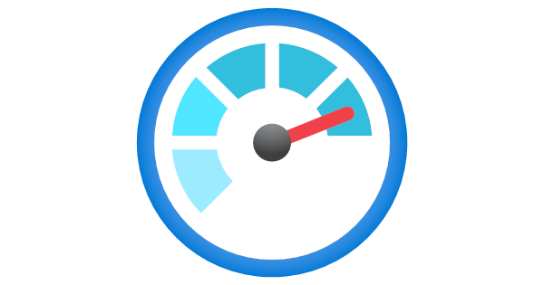

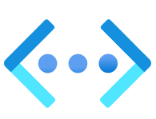
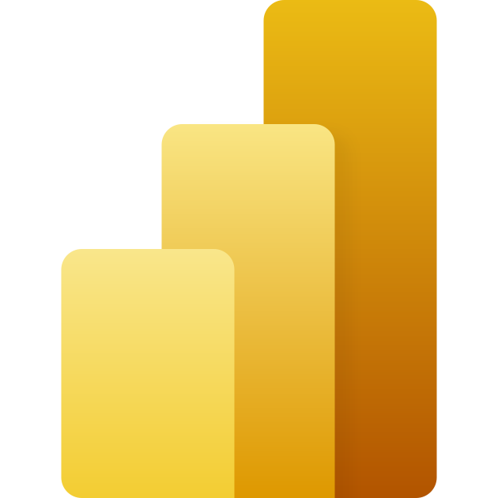
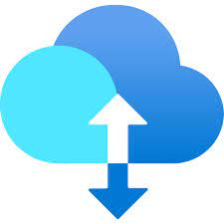
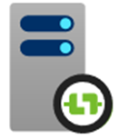

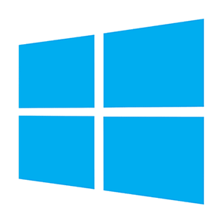
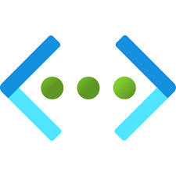
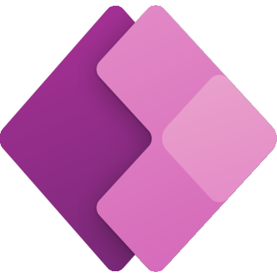


Network Diagram
Legend
Private endpoint
Azure Tenant
Service endpoint
Network security group
*
Future phase
PVCFC Source Systems (1)
Azure Active Directory
(IAM service, manages AuthN and AuthZ)
S2S VPN / ExpressRoute gateway
ADLS Gen2
Blob storage (for user files upload)
Firewall
Gateway subnet
VNET Peering
Synapse Dedicated Pool
Synapse Data Analytics
Key Vault
(Protects app credentials)
Synapse Analytics
RXT engineers (accessed into PVCFC VPN)
DNS server
Azure Monitor
(Logs, Metrics)
DNS subnet
Application subnet
Hub VNET
Synapse Serverless Pool
PBI Service
PVCFC Source Systems*
Source system which are on On-premise: S2S VPN (SAP ECC, DMS)
Data gateway VM
Self-hosted Integration Runtime (SHIR) VM
Managed private endpoints
Automation account
(Automation scripts to save cost)
Gateway subnet
Data Platform VNET
Synapse managed VNET
ADLS – Staging
PowerApp
Azure DevOps Repos
(Source code management)
Shared services
Notes:
Demand on VM or can access via PVCFC VPN

Slide 7
Ingestion Network Flow
Ingest data from PVCFC application (SAP ECC system and DMS on-premise) and load it into Azure Data Lake. Copy activity of Synapse pipeline shall be used for ingesting data into landing layer.
Users upload manual files into Blob Storage via Azure Storage Explorer or Azure Portal
Legend
Private endpoint
Service endpoint
Network security group
*
Future phase
Azure Tenant
PVCFC Source Systems (1)
Azure Active Directory
(IAM service, manages AuthN and AuthZ)
1
S2S VPN / ExpressRoute gateway
5
Firewall
Blob storage (for user files upload)
Gateway subnet
6
7
Key Vault
(Protects app credentials)
Synapse Dedicated Pool
PVCFC Source Systems*
Source system which are on On-premise: S2S VPN (SAP ECC, DMS)
Azure Monitor
(Logs, Metrics)
DNS server
4
ADLS Gen2
DNS subnet
Hub VNET
Application subnet
Control Plane subnet
Automation account
(Automation scripts to save cost)
Self-hosted Integration Runtime (SHIR) VM
2
3
ADLS – Staging
Gateway subnet
PowerApp
Data Platform VNET
Synapse managed VNET
Azure DevOps Repos
(Source code management)
Shared services
Notes:
Upload files via Power App or directly into Blob Storage (storage explorer or azure portal)

Slide 8
Ingestion Connection Table
# | Source | Target | Protocol / Port | Authentication Mechanism | Purpose of Connection | Traffic Type | Notes (latency , through put, special security)
1 | Data Source type 1 | SHIR VM | /16 | AAD user credential / SAS | Ingest data from Data Source type 1 (SAP ECC and DMS) | North-South (is network traffic flowing into and out of a data center) | Requires high throughput
2 | Power App | ADLS - Staging |  | Managed Identity | Upload manual files via Power App or input data through data form | North-South | Require high throughput
3 | SHIR VM | ADLS - Staging | HTTPS | Managed Identity | Read Data from ADLS - Staging | East-West | Require high throughput
4 | SHIR VM | ADLS | HTTPS | Managed Identity | Write Data to Landing on ADLS | East –West (transfer of data packets among different Vnet within a data center) | Require high throughput
5 | SHIR VM | Blob Storage | HTTPS | Managed Identity | Read Data from Blob Storage, where users upload manual files | East –West | Require high throughput
6 | SHIR VM | Key Vault | HTTPS | Managed Identity | Read Secrets keys to access source system authentication | Within VNET
7 | SHIR VM | Synapse Dedicated Pool | HTTPS | Managed Identity | Read Data From Synapse Dedicated Pool | East-West

Slide 9
PBI Network Flow
Legend
Private endpoint
Service endpoint
1
Network security group
PBI Service
Azure Tenant
*
Future phase
Azure Active Directory
(IAM service, manages AuthN and AuthZ)
2
ADLS Gen2
3
4
Synapse Dedicated /Serverless Pool
Azure Monitor
(Logs, Metrics)
Blob storage (for user’s files upload)
Application subnet
Automation account
(Automation scripts to save cost)
Data gateway VM
Azure DevOps Repos
(Source code management)
Gateway subnet
Data Platform VNET
Shared services

Slide 10
PBI Connection Table
# | Source | Target | Protocol | Authentication Mechanism | Purpose of Connection | Traffic Type | Notes (latency , through put, special security)
1 | PBI Gateway (SHIR VM) | Power BI Service | HTTPS | AAD user credential | Dataset refresh requests | North-South
2 | PBI Gateway (SHIR VM) | ADLS Gen2 | HTTPS | AAD user credential / SAS | Data refresh from ADLS storage | East-West | High Throughput
3 | PBI Gateway (SHIR VM) | Blob Storage | HTTPS | AAD user credential | Data refresh from Azure blob storage | East-West | High Throughput
4 | PBI Gateway (SHIR VM) | Synapse Dedicated Pool | TCP | AAD user credential | Data refresh from Synapse Dedicated Pool | East-West | High Throughput

Slide 11

Admin/User Network Flow
Legend
Azure Tenant
Private endpoint
Service endpoint
Network security group
*
Future phase
3
5
Azure Active Directory
(IAM service, manages AuthN and AuthZ)
VNET Peering
ADLS Gen2
Blob storage
S2S VPN / ExpressRoute gateway
PVCFC Admin/Users
(PBI Desktop, Azure Data Studio, Storage Explorer and other clients)
7
Gateway subnet
Synapse Analytics
Key Vault
Synapse Dedicated / Serverless Pool
4
6
Azure Monitor
(Logs, Metrics)
DNS server
DNS subnet
Application subnet
Hub VNET
Automation account
(Automation scripts to save cost)
Data gateway VM
Self-hosted Integration Runtime (SHIR) VM
1
Gateway subnet
2
Data Platform VNET
8
Azure DevOps Repos
(Source code management)
PowerApp
ADLS Gen2
Shared services
Notes:
Remove Working VM for RAX (2023-06-02)

Slide 12
Admin/User Connection Table
# | Source | Target | Protocol | Authentication Mechanism | Purpose of Connection | Traffic Type | Notes (latency , through put, special security)
1 | Business User/ Power User/IT Users | Data gateway (SHIR VM) | RDP | AAD user credential | IT User to RDP into Data gateway VM from their local desktop for configuring and maintaining VM. | East-West
2 | Business User/ Power User/IT Users | SHIR VM | RDP | AAD user credential | IT User to RDP into SHIR VM from their local desktop for configuring and maintaining VM. | East-West | Low Latency preferred
3 | Business User/IT Users | ADLS Gen2 | HTTPS | AAD user credential / SAS | Customer to connect to ADLS Gen2 from their local desktop for files/development. | East-West | Low Latency preferred
4 | IT Users | Synapse Analytics | TCP | AAD user credential | IT User to connect to Azure SQL from their local desktop for development. | East-West | Low Latency preferred
5 | Business User/ Power User/IT Users | Blob Storage | HTTPS | AAD user credential | Users to connect to Blob storage from their local desktop to upload manual files. | East-West | Low Latency preferred
6 | IT Users | Key Vault | HTTPS | AAD user credential | IT User to connect to Key Vault from their local desktop for secret management. | East-West
7 | Business User/IT Users | Synapse dedicated pool | TCP | AAD user credential | Customer to connect to Synapse dedicated pool from their local desktop for development. | East-West | Low Latency preferred High Throughput
8 | Business User/ Power User/IT Users | Power App | HTTPS | AAD user credential | Users to upload manual files and input data through data form | North-South

Slide 13
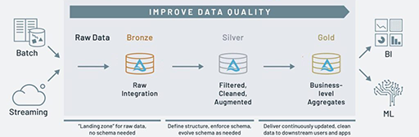
Medallion Architecture
A medallion architecture is a data design pattern used to logically organize data, with the goal of incrementally and progressively improving the structure and quality of data as it flows through each layer of the architecture (from Bronze ⇒ Silver ⇒ Gold layer tables)
Bronze layer (raw data): are tables, storing one to one copy of data from various source systems without any transformation
Silver layer (cleansed and conformed data): are fundamental data entities built on top of bronze data tables providing enterprise view of key business entities
Gold layer (curated business-level tables): re use-case ready tables implementing specific business rules, calculations, and aggregation.
Notes:
Split copy activity into 02 stages (ingest into landing firstly (folder Inbox) and move into process folder) -> inbox empty
+ Full load
Landing (SRI): parquet
Source / Inbox : Ingest entire table into folder Source (flat)
Processed: Moved after loading successfully into Bronze
Date (Year/Month) / Table Name (BSEG) / *.parquet
Failed: Moved after loading failed into Bronze
+ Incremental Load
Landing (SRI): parquet
Source / Input: Ingest table (for example BSEG > 01/Jun/23) into folder Source
(Loop pipeline for one each table)
Bronze (split into etl, sap, dms, manual)
(real: 400 dif systems, sap_906, sap_907)
- T001
- BSEG
MARA
VBRK
VBRP
Silver (Physical Table) (source items -> key, besides order no, order item)
Renaming
Filtering (delete flag)
Derived
Cleansing
Join / Look up
Filtered and cleansed copy of data
Augmented (denormalization or joining columns from multiple tables)
Un-nesting or putting concrete column names for flexible fields
Standardization: unit of mass, code values
Integration (stack up) of similar datasets from multiple bronze tables
Deduplication and compaction (latest version if there are multiple updates maintained as separate records in bronze)
Same granularity as underlying bronze tables
For example: Inventory Details -> Inventory Balance / Aging (snapshot)
For example:
Fact_Billing_Order_Item (VPRK_VBRP)
Dim Material (MARA)
Gold (View) -> Consumption
Aggregate Data
Filtering
Derived
Another name prefix (Pull data for app) (3rd dept purpose)
For example:
Fact_Billing_Order_Item
Dim Material
Fact Monthly Billing (Aggregate from fact billing order item)

Slide 14
Synapse Dedicated Pool vs Serverless Pool
Dedicated SQL Pool | Serverless SQL Pool
Allows you to run a query and ingest data from the business’s data lake files | Allows users to query their data lake files
Demands an infrastructure set up | Not required to set up an infrastructure or maintain clusters
Need to acquire dedicated servers before conducting any operation | Seamless data transformation and exploration without any infrastructure in place
Data is stored in relational tables | Data is stored in Data Lake
Cost is managed by pausing SQL pool or scaling down warehouse | Cost is automatically handled and invoiced on a pay-per-query basis
Cost is incurred for the resources reserved | Cost is incurred for the data processed per query
Pay per DWU provisioned | Pay per TB Processed

Slide 15
Considerations for network design
All PaaS services configured with private endpoints
All traffic across Data App and source system goes through landing zone and firewall
All traffic from user to Data App services (web endpoints) will go through landing zone firewall
All traffic within Data App VNET will NOT go through firewall. However, NSG rules defined to allow/deny setup subnet- to subnet traffic. Traffic within subnet will not have any restriction
Separate VNET for each environment

